Slide 1
Institutional Analysis
Alexandra Benham
The Ronald Coase Institute
Lee Benham
Washington University & The Ronald Coase Institute
PIDE, Islamabad May 15, 2007

Slide 2
The Ronald Coase Institute
Mission:
To better understand how
real economic systems work,
so that individuals and societies
have greater opportunities
to improve their well-being.
www.coase.org

Slide 3
Our current objectives
To lower the transaction costs of scholars cooperating around the world on the analysis of institutions
To run selected workshops and research seminars in Asia

Slide 4
In Pakistan the institutions--the formal and informal rules of the game-- are fundamental to economic performance.
New Institutional Economics provides some tools to help local scholars understand the link between institutions and outcomes.

Slide 5
Institutions = rules of the game
  formal rules
  informal rules
  their enforcement

Slide 6
New Institutional Economics
  Adds
  a theory of institutions (rules of the game) to neoclassical economics
  Examines
  how the rules of the game affect economic growth and the structure of the economy
  how the rules of the game evolve

Slide 7
Foundations from neoclassical economics
Scarcity and competition
Opportunity costs
Marginal analysis
Equilibrium, the Invisible Hand,
and the Law of One Price
Gains from trade
Specialization and extent of market

Slide 8
Elements of
New Institutional Economics
Property rights
Transaction costs
Path dependence: role of
historical experience
Law and Economics
Regulation
Governance
Informal norms of behavior

Slide 9
References for Institutional Analysis
Menard and Shirley, eds., Handbook of New Institutional Economics
Douglass North, Structure and Change in Economic History
www.coase.org

Slide 10
Property Rights
Ronald Coase, social costs
Yoram Barzel, property rights
Gary Libecap and Lee Alston, Brazil
Sebastian Galiani, property rights
Handbook of New Institutional Economics
www.coase.org

Slide 11
Transaction Costs
Ronald Coase
Oliver Williamson

Slide 12
A conclusion of
New Institutional Economics
Clear definition of rights
and clear enforcement of them
are fundamental to
good economic performance

Slide 13
Investigating
economic change
  We know very little about the
  dynamics of economic change
  To understand more,
  it is essential to know more about
  the options individuals actually face
  over time

Slide 14
Investigating
economic change
  Today we’ll consider
  Better measurement
  Broader sets of responses to
  regulation

Slide 15
Outline of talk
Measuring the costs of exchange
Example: actual costs of
registering a new firm officially
in different countries
Relevance for Pakistan

Slide 16
Transaction costs
are a significant component
of the options that individuals face

Slide 17

Transaction costs
A small or even unobserved change
in transaction costs
can lead to
dramatic changes in productivity
or in the structure of organizations
    (Adam Smith, Ronald Coase)

Slide 18
To understand and affect transaction costs, we need to know
How big are they?
Which are the highest?
Who pays more – or less?
What happens after reforms?

Slide 19
To discover these things,
we need a better
measurement instrument

Slide 20
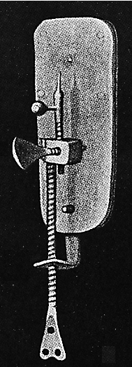

Slide 21
Cost of exchange C_{ijkm} =
opportunity cost in total resources
(money, time, goods)
for
an individual with characteristics i
to obtain a good/accomplish a goal j
using a given form of exchange k
in institutional setting m

Slide 22
This instrument the costs of exchange
Measures what?
Opportunity costs –
the actual costs people incur when they carry out a specified transaction
Measures how?
Asks those who have carried out
that kind of transaction about the
detailed costs they incurred to do it
(case studies and surveys)

Slide 23
Example: measuring the costs of exchange of registering a new firm officially
Components
Official fees (registration, licenses, etc.)
Value of entrepreneurs’ and staff’s time
spent registering
Payments to facilitators (official and
unofficial)

Slide 24
We looked for variation in costs
by country or region
by size of firm
by gender
by ethnic group
by prior experience

Slide 25
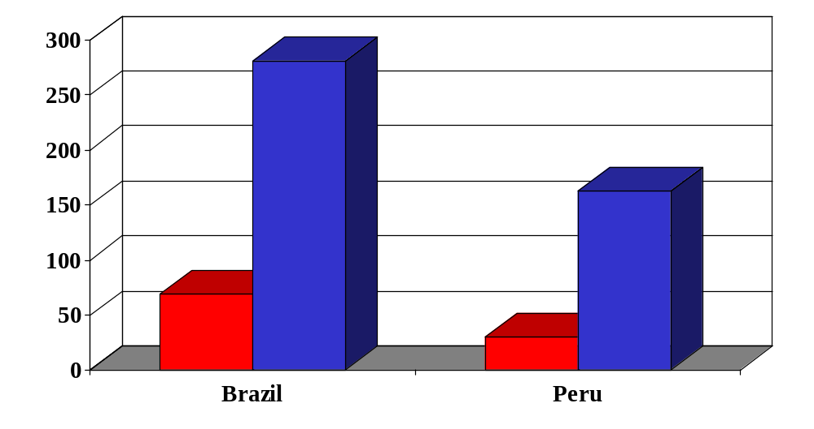
Brazil and Peru:
Time costs and total costs of exchange, 2003
$
Total cost of exchange
Time cost

Slide 26
Costs varied widely in Brazil
Firms paying < $150 | Firms paying > $400
33% | 17%

Slide 27
Costs varied widely in Peru
Firms paying < $50 | Firms paying > $200
34% | 13%

Slide 28
Variation in some costs of exchange
we observed across several countries
in the early 1990’s
Cost of obtaining a landline telephone
within two weeks
Highest observed $6,000 Argentina
Lowest observed $130 Malaysia
Ratio high/low 46
Waiting time to clear a shipment of goods in port
Highest observed 14 days Tanzania
Lowest observed 15 minutes Singapore
Ratio high/low 1,344

Slide 29
This instrument the costs of exchange
Measures elements of transaction costs in a new and systematic way
Like a microscope - has a narrow focus but shows things not heretofore seen

Slide 30
What does this instrument reveal?
The costs of exchange – say, of registering a new firm officially - are often dramatically higher than the official money price
There are great variations in costs of exchange
across countries
across individuals
The law of one price does not apply

Slide 31
How is this instrument useful?
Helps new entrepreneurs know the real costs
Makes processes more transparent
Reduces officials’ discretion
Encourages competition among jurisdictions
Informs citizens and officials
Tracks the actual effects of reforms
Monitors system through time

Slide 32
This instrument is not the only way to measure transaction costs
This measure – like GNP or price indices – is arbitrary
Does not resolve all conceptual and measurement problems
It is time to move from concept to measurement

Slide 33
Bangladesh - registering a new firm & getting permits
Time spent: 146 days
Total opportunity cost:
$4,231 to $5,825
($5,825=14.2 times GNI per capita)
World Bank estimate - cost of
registering a new firm: $272

Slide 34
Why are the costs so high in Bangladesh?
Special permits are needed to import textiles intended for re-export
Regulations are designed to maintain high tariffs on internal consumption of textiles
Regulations change frequently in response to people’s efforts to use
re-export textiles internally

Slide 35
What next?
Examine other transactions:
transferring property, etc.
Look for situations
where the costs of exchange differ
Look at
the consequences of these differences

Slide 36
Effects of land titling on the poor
  Sebastian Galiani &
  Ernesto Schargrodsky
  Squatters in Argentina
  Unanticipated distribution of land titles
  to some and not others
  Consequences observed
  http://coase.org/workingpapers/wp-7.pdf

Slide 37
Effects of Land Titling on Poverty
Galiani & Schargrodsky
INITIAL SITUATION OUTCOME CONSEQUENCES
Tract was actually owned by many different private owners:
some then sold their land to the government, others refused
Squatters living in some parts of the tract received title to their land
Argentine squatters occupied large tract of vacant land (believing the government owned it)
Entrepreneurial credit and earnings
Investment in house
Household structure
Education of children
Other squatters still have no title to their land

Slide 38
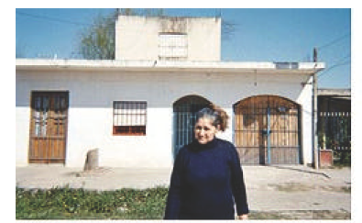
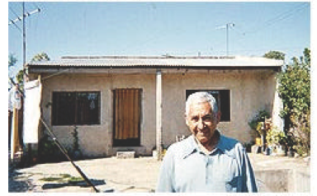
(Galiani’s slide)
Treatment Control
Mercedes Almada (left) and Valentín Orellana (right), stand in front of their houses in San Francisco Solano barrio outside Buenos Aires. Ms. Almada holds the title to her land; Mr. Orellana does not. (Matthew Moffett, The Wall Street Journal)

Slide 39
Galiani & Schargrodsky: Conclusions
People who got title to their land
Modest increase in access to mortgage credit
No impact on access to other credit
No effect on labor income
Lower fear of eviction, burglary, occupation by
other squatters
Increased investment in the house
Lower fertility of household heads and of teenagers
Fewer extended family members present
More education of children - on average 1.5 years

Slide 40
Investigating changes in a system
When a regulation is changed, what types of legal and illegal responses can follow?
See Handbook of New Institutional Analysis,
Menard and Shirley, editors

Slide 41
The rules of the game form a system
Altering the rules in one area will change the system elsewhere
The forms of this change will depend on local conditions, history, interest groups, options

Slide 42
Response to change in regulation - when free trade began between India and Nepal
Official customs fees were abolished
Customs officers then charged traders
for facilitating the passage of their goods across the border
Traders’ actual costs of exchange to move goods across the border remained much the same

Slide 43
Applications to Pakistan
How much does it cost to do a particular form of business in various parts of Pakistan?
For example, what does it cost to transfer title to property in different regions?

Slide 44
Recognize and study relative success

Slide 45
Look for the gold

Slide 46
Legal responses to regulation
Substitution of other goods other attributes of goods amenities barter vertical integration household production personalized exchange

Slide 47
Legal responses to regulation
Changes in governance and contractual relationships organization of the market

Slide 48
Illegal responses to regulation
  Development of
  underground economy
  private coercion
  extralegal organizations
  discrimination
  corruption

Slide 49
One regulation can
lead to other regulations
create long-lasting interest groups

Slide 50
Use costs of exchange to investigate responses to regulation
Individuals and systems respond
along many dimensions
to changes in regulation
Measuring the costs of exchange
allows us to trace out multiple consequences
of these responses

Slide 51
What next?
Try to discover
what rules of the game
cause the costs of exchange to differ
Examine the evolution of rules

